Slide 1



Elementary School
Gifted and Talented Education Program

Slide 2


Our GT Staff
Katie Barbagallo
Michaeline Van Reenan

Slide 3
GT Education Program Mission
To recognize and develop talent in ALL learners, including those already performing at advanced levels.

Slide 4
Program Components
Primary Talent Development
G/T Instructional Seminars
G/T Math
Curriculum Extension Units (CEUs)
Research Investigations

Slide 5

Talent Development Offerings:
Primary Talent Development
Push-in model in K and 1
Encourage development of creative and analytical reasoning
Extend learning for students already performing at advanced levels

Slide 6
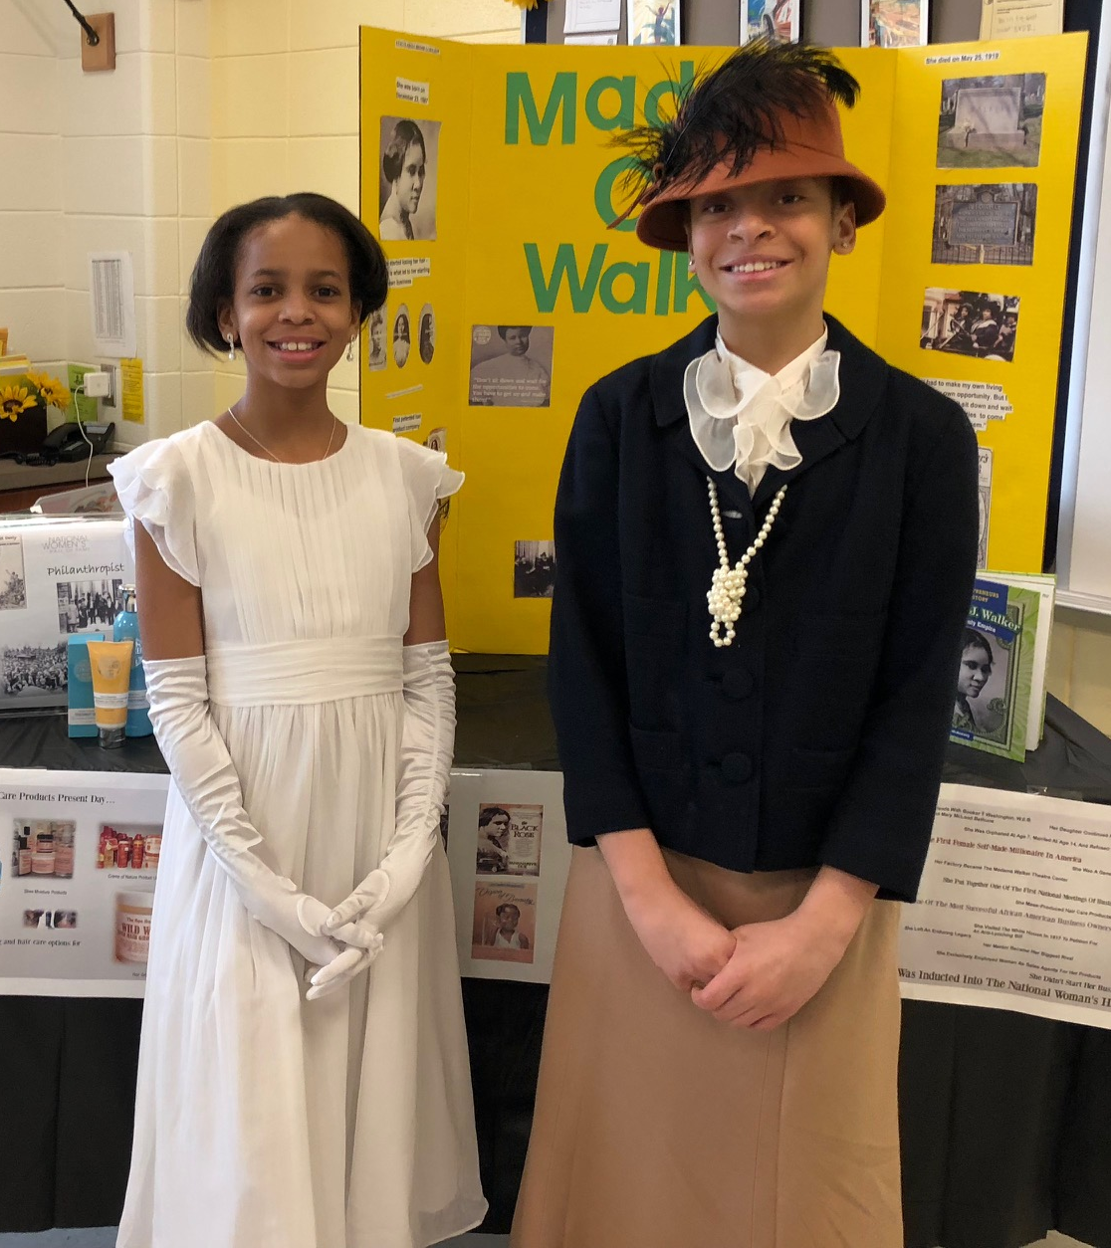
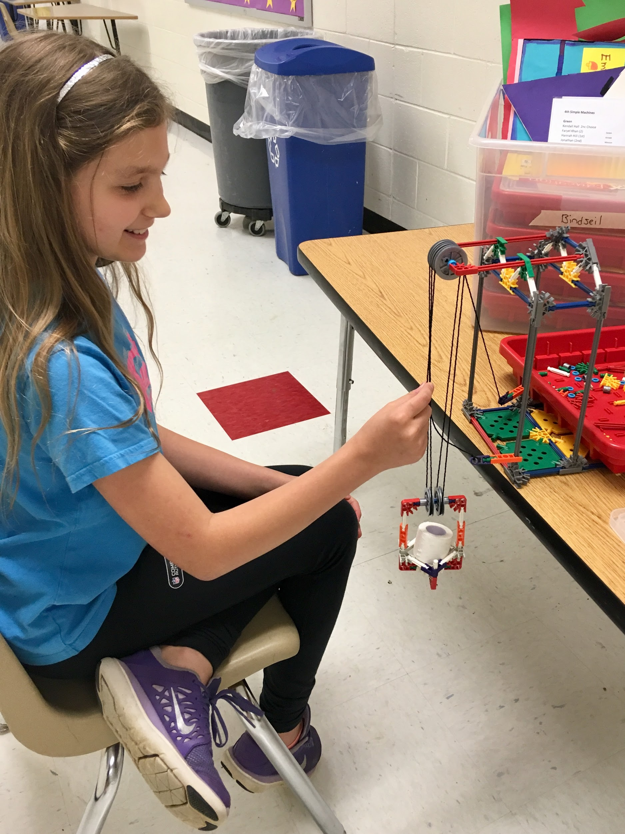
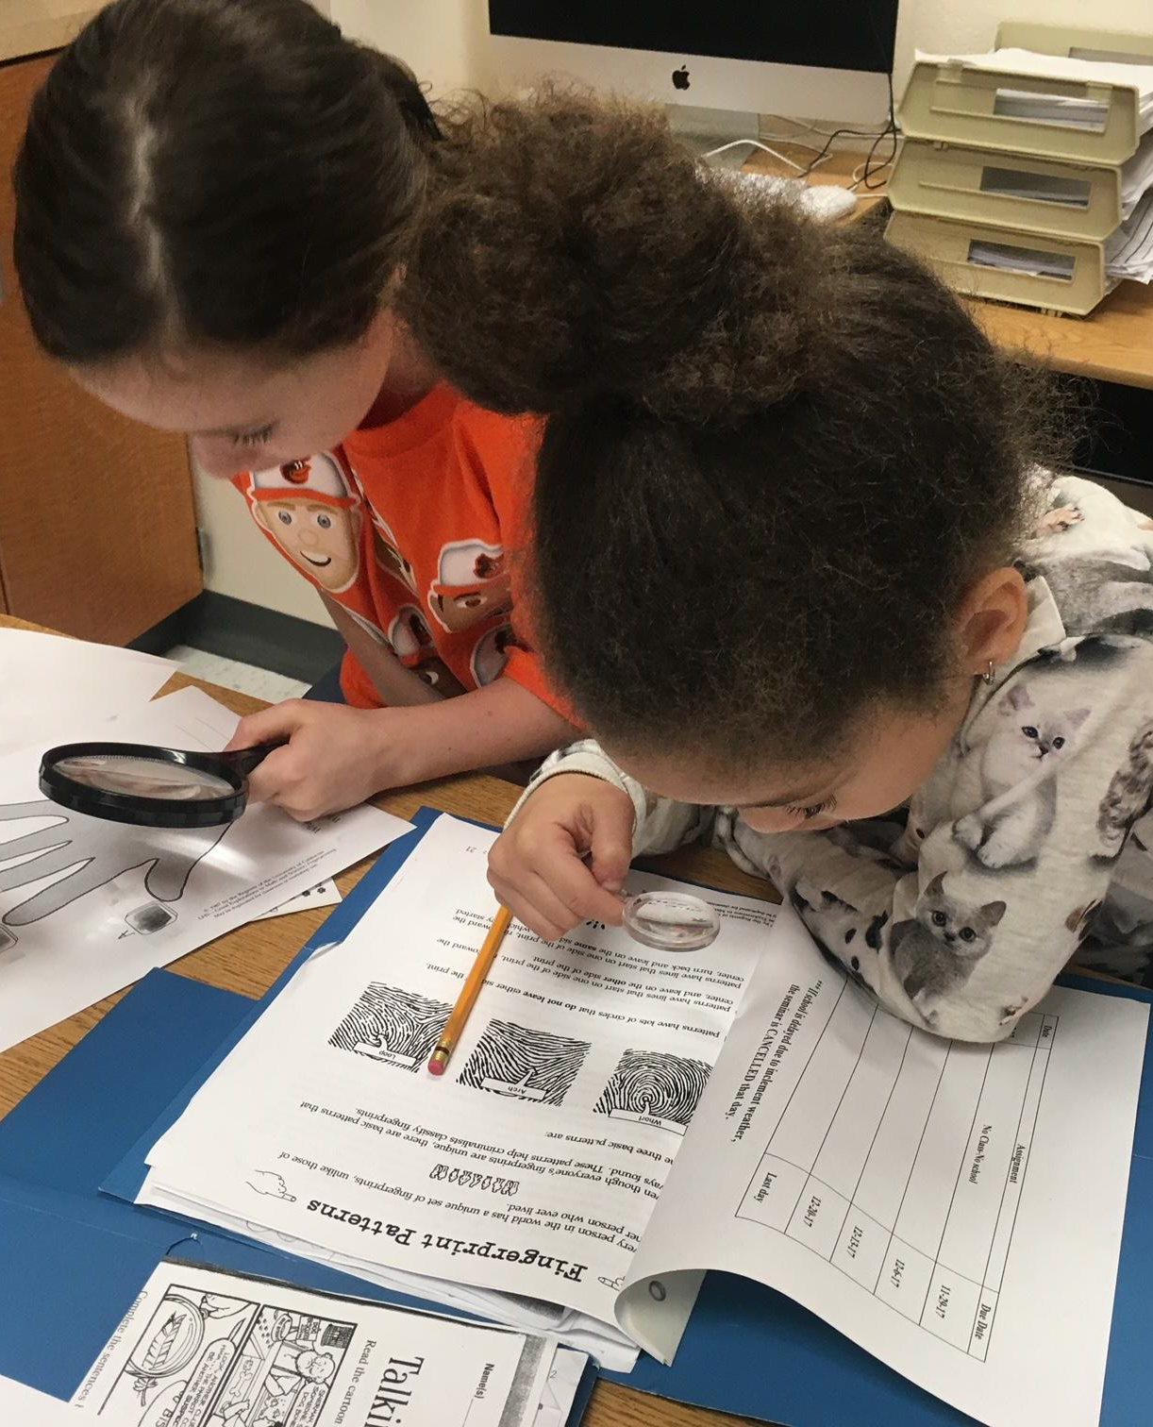
Talent Development Offerings:
GT Instructional Seminars
Instruction in Advanced-Level Skills
Open to All Interested Students
Creative Production or Inquiry

Slide 7
Sample GT Instructional Seminars at Our School
Unheard Perspectives (4th and 5th)
Coding
Build It
Cardboard Challenge
The Crayon Project
Tiny Houses (Engineering)
Debate
Book Club
Writing Club
Logical Reasoning
Origami
Science Mysteries
Chemistry
Animal Conservation

Slide 8
Where can I find out more about GT Instructional Seminars at our school?
Our school website
Fliers sent home with your students
School’s GT Resource Team
School’s HCPSS News
Interest forms in Wednesday Folders

Slide 9
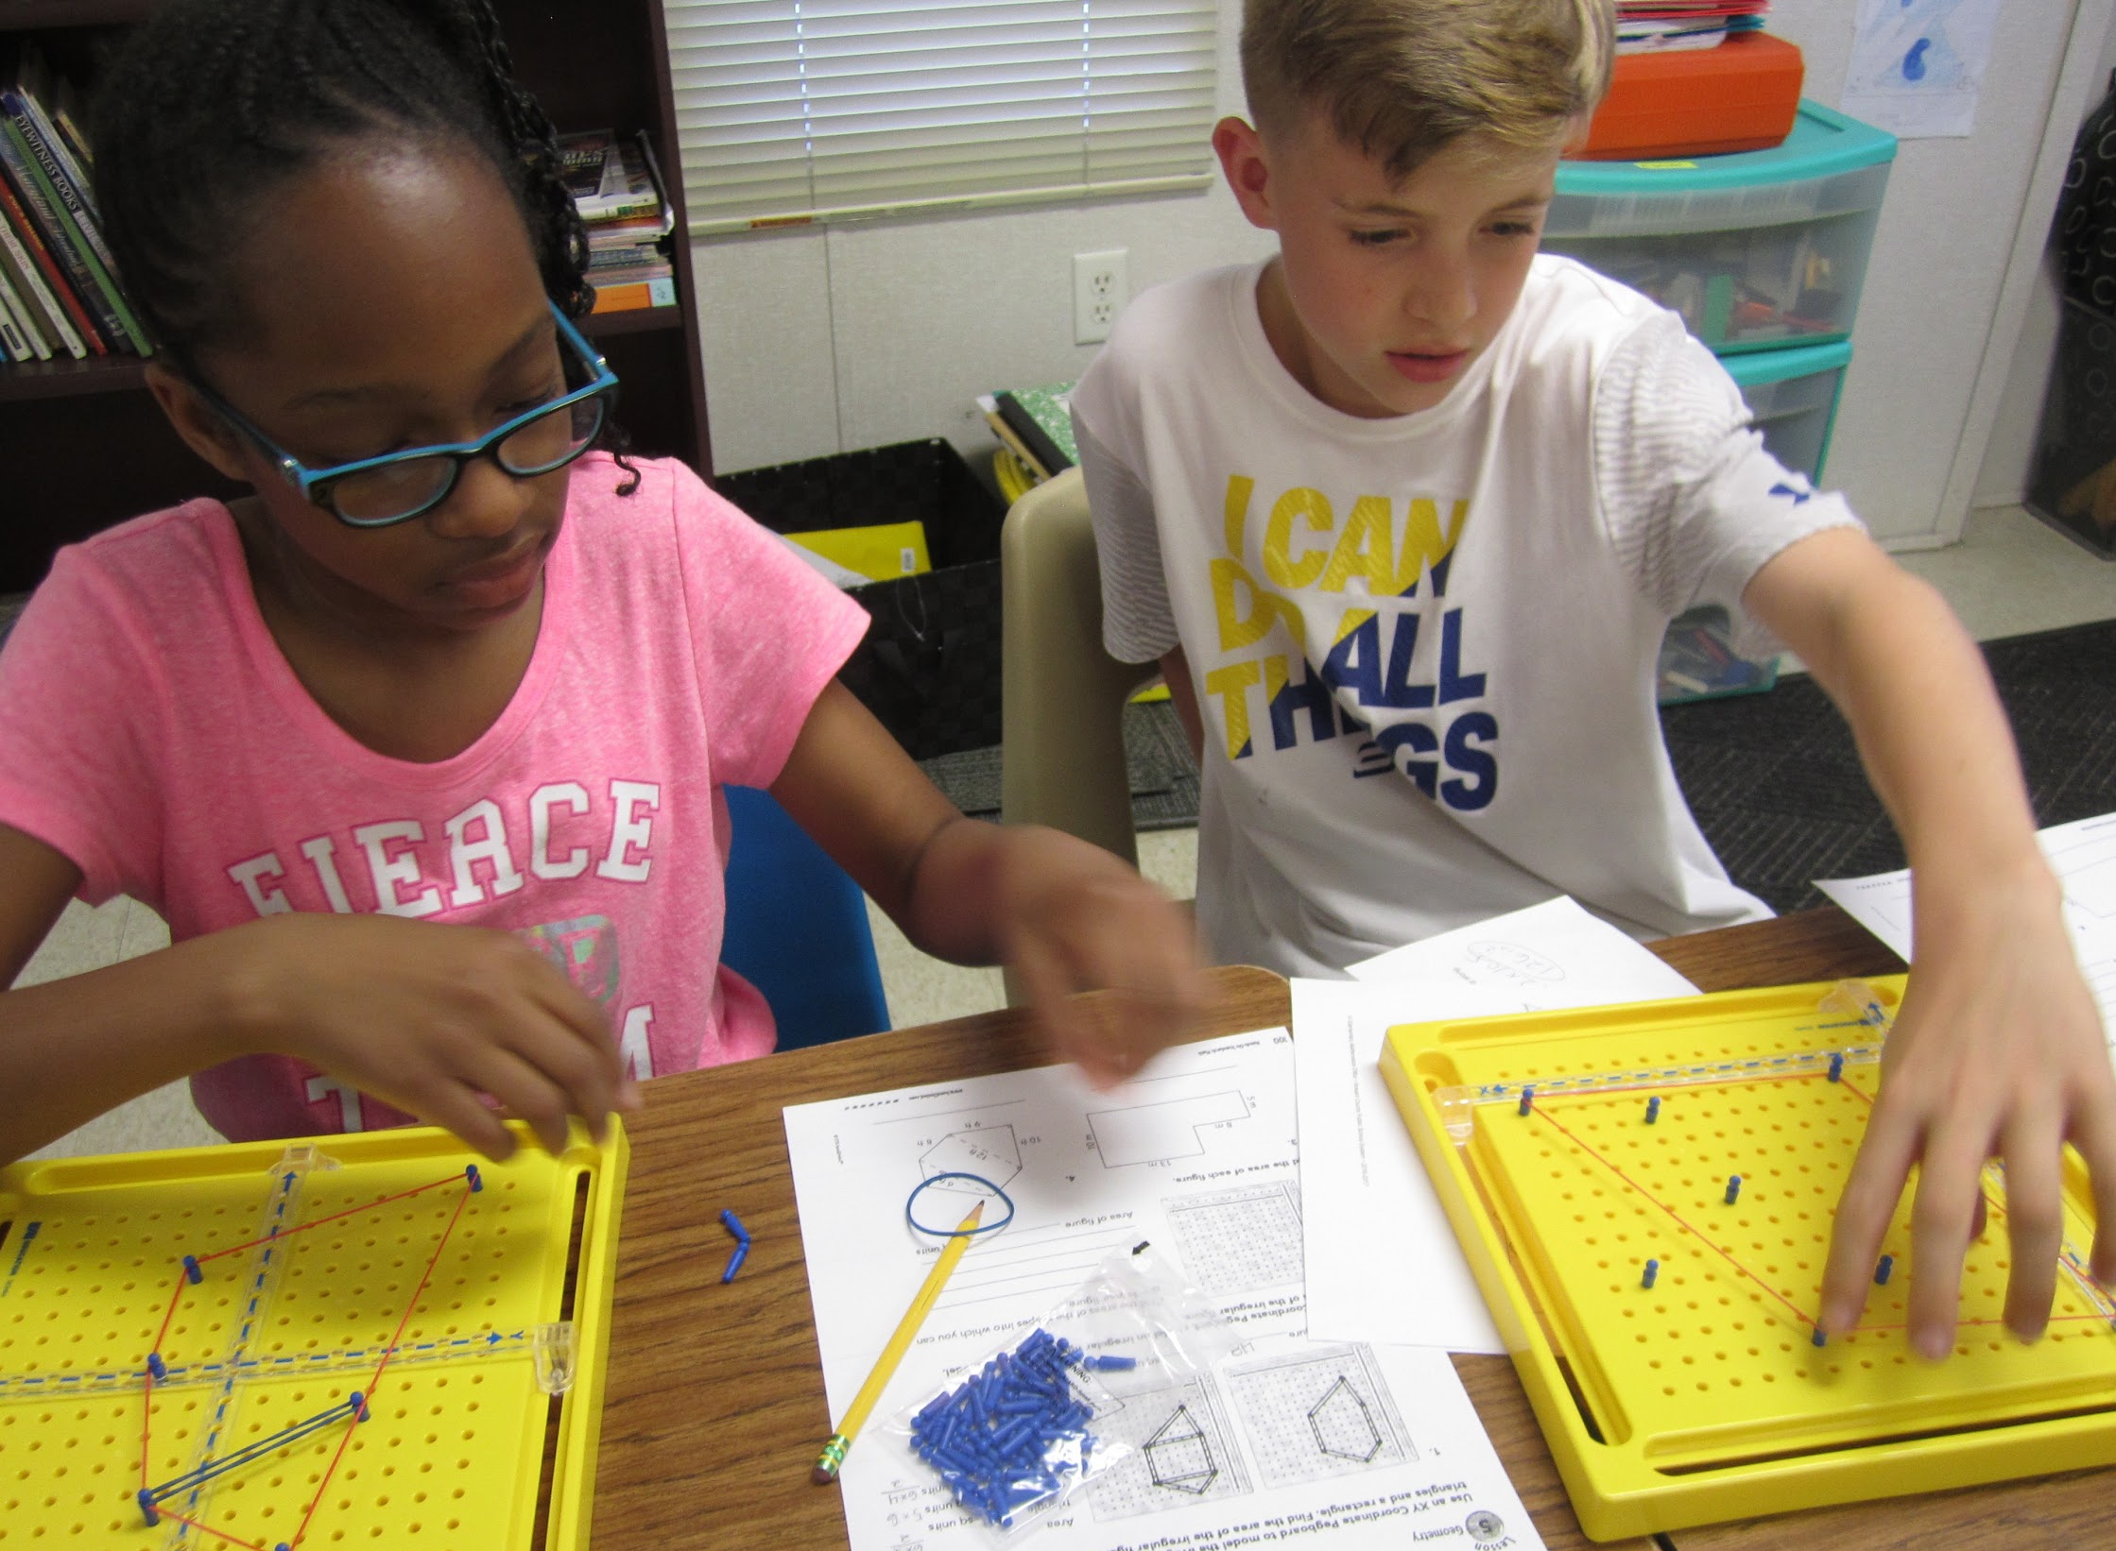
Accelerated and enriched curriculum
Focus on problem solving and application of mathematics
Daily instruction
GT Mathematics

Slide 10

4th Grade GT Math Domains
Expressions and Equations
Place Value and Decimals
Multiplication and Division
Fractions
Geometry and Measurement
Statistics

Slide 11

5th Grade GT Math Domains
The Number System
Ratio and Proportion
Expressions and Equations
Geometry

Slide 12
Placement Process for GT Math
CogAT administered to ALL students in December of 3rd grade.
  Meets State COMAR requirement for an ability measure.
  Helps identify students who may underperform in school.
All students reviewed as part of G/T Placement Process using multiple criteria.

Slide 13
Measures Included in Placement Process
Ability Measure (CogAT or SCAT)
Standardized assessments (MAP, PARCC)
Student work samples
  Application
  Analysis
  Problem Solving
Student grades on assignments requiring critical, analytical, and/or creative thinking
Documentation from families

Slide 14
How can families support the placement process?
Provide the school information regarding your child’s academic strengths, including activities outside of school.
Request clarification regarding your child’s strengths and/or challenges in a class.
Communicate regularly with the GT Resource Teacher.

Slide 15
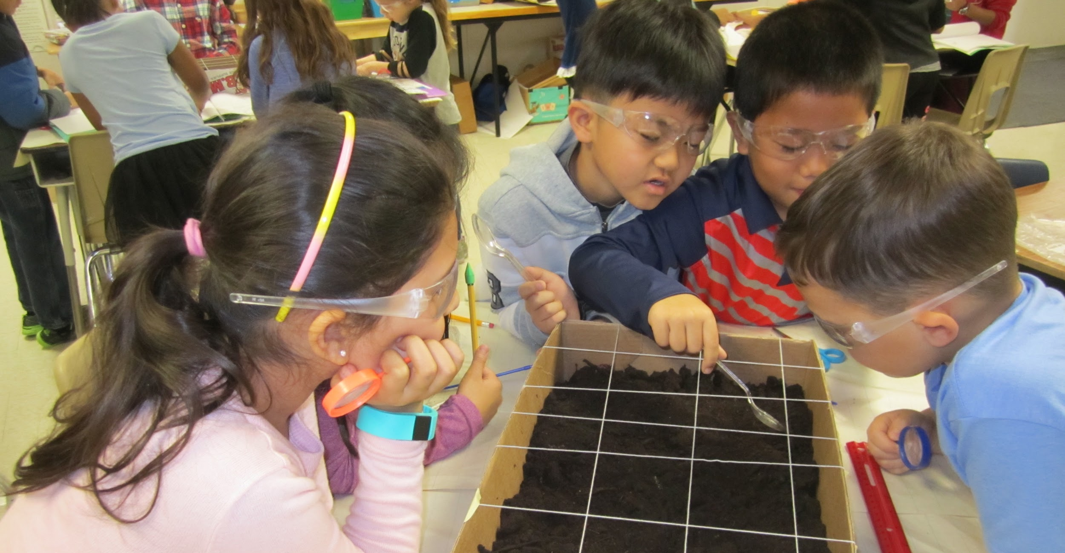
GT Curriculum Extension Units

Slide 16
Curriculum Extension Units
2nd Grade
World Cultures
Archaeology
Economics of Production
3rd Grade
Immigration
Weather
Logic and Reasoning
4th Grade
Systems and Settlements in the New World
Our Place in Space
Waves of Communication
5th Grade
River Watch
Ocean Systems
Authenticity

Slide 17
Curriculum Extension Units (CEUs)
Interdisciplinary
Advanced-level content
2-3 per grade lasting approximately 9-12 weeks each, depending upon whether daily or biweekly
All students considered as part of GT CEU Placement Process using multiple criteria.

Slide 18
Placement Process for CEUs
Talent Spotting Lessons conducted in all classes
Multiple performance measures used to indicate readiness for participation.
  Performance tasks
  Writing samples
  Standardized test scores (MAP, PARCC, CogAT for 4th and 5th)

Slide 19

Supporting Your Child
Communicate with your child’s classroom teachers and the GT Resource Teacher.
Encourage your child to take advantage of enrichment opportunities, such as GT Instructional Seminars.
Notes:
.
Photo from https://www.publicdomainpictures.net/en/view-image.php?image=65955&picture=schoolboy-is-sitting-on-books

Slide 20
Nurturing Advanced Behaviors at Home
Advanced Language | Logic and Reasoning | Motivation and Persistence | Leadership | Perspective
Increase use of sophisticated language. | Share your thinking. Think sequentially. | Ask thought- provoking questions. | Show how you solve problems. Discuss strategies and create new ways to solve problems. | Discuss various perspectives.
Ask provocative questions. | Take things apart and put back together – ideas, objects or experiences. | Encourage independence. | Model taking initiative. | Demonstrate and model flexibility in your thinking by examining opposing points of view.
Point out similarities and differences. | Organize collections or ideas in insightful ways. | Show curiosity about ideas, events, experiments, experiences. | Set high expectations. | Embellish/ expand thoughts, perspectives, etc.

Slide 21
Opportunities for Parent Engagement
Become a GT Resource volunteer.
GT Parent Academies
Become a GT Parent Representative
HCPSS News for GT Program Information
Follow HCPSS_GT Twitter

Slide 22

For More Information
Our school website
HCPSS GT Program website at www.hcpss.org/gt
NAGC website at www.nagc.org
Our GT Resource Team

Slide 23
G/T Parent Rep Information

Slide 24


